Slide 1


Government Polytechnic Mumbai
Name of dept.: Electronics Engineering,Term: Odd 20-21
Course Title:Project and Seminar I,Course Code:EC16306
Name Of Guide.: MRS.B.J.NIMBALKAR
YEAR.: 3rd 2nd shift
Name Of Project.:Wireless Home Automation System using Receiving SMS
Project Presentation
Enrollment No:-
SD19EC030 SD19EC026 SD19EC031 SD19EC034
Students Name:- Praful Shirke Abbasali Jamadar Alok Jaiswal roshan gupta

Slide 2
how is a Wireless Home Automation System using Receiving SMS ?
The microcontroller will extract the message from the received SMS and control the relay module. The relay will turn on or off the appliances as ordered by the owner. The advantage of the project is even if the owner does not have an android phone the can send a SMS to the GSM modem to control the appliances.
the home appliances from remote places anywhere in the world. This system allows the owner to control the appliances and to.

Slide 3
Working of Project:-
In this post we are going to build a home automation circuit by which you can control your home gadgets via GSM network or in other words using SMS commands, you can control up to 5 devices independently. The proposed GSM based home automation system is loaded with several features that make this project standout, like: password protected control for all outputs, automatic recovery from power outage, acknowledgement SMS to the user. We will also see how to automate SMS commands so that you can schedule your commands and execute without your intervention.

Slide 4
Applications of Project:-
The project can be put to use in the following field,
Home automation, which was the seed for developing the idea of project.
Remote device control.
This will help to eliminate need of human personnel attending the device till it has to be switched off/on. Based on experience of approximate time to switch on/off, He'she can control the device, saving time.
It will also help to control device while attending to other work.
User can control device in case of forgetting to do so while leaving for some other place.
Energy conservation.
Irrigation systems.

Slide 5
Hardware Used:-
Arduino UNO board
SIM 900A GSM Module
A 3 Channel Relay
AC 230v Power Supply
relay light detector sensor
3 Bulb Holder
3 Bulbs
Jumper Wires Hardware
wires Solid type
DC Male and Female Jack Combo
Eveready 9V Battery and Battery Holder Clip
etching pcb kit
PCB soldering kit

Slide 6
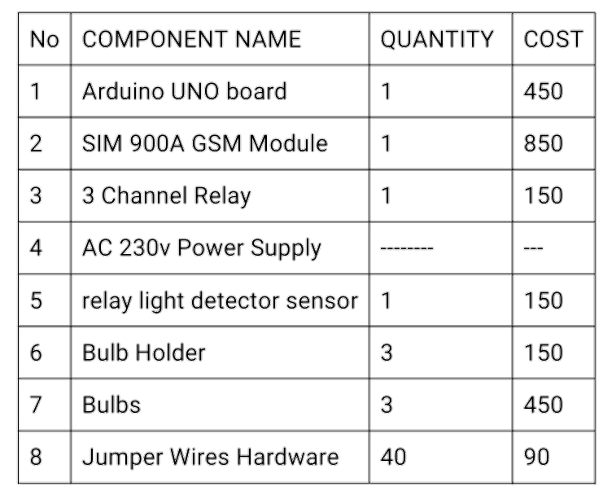
Components cost:-

Slide 7
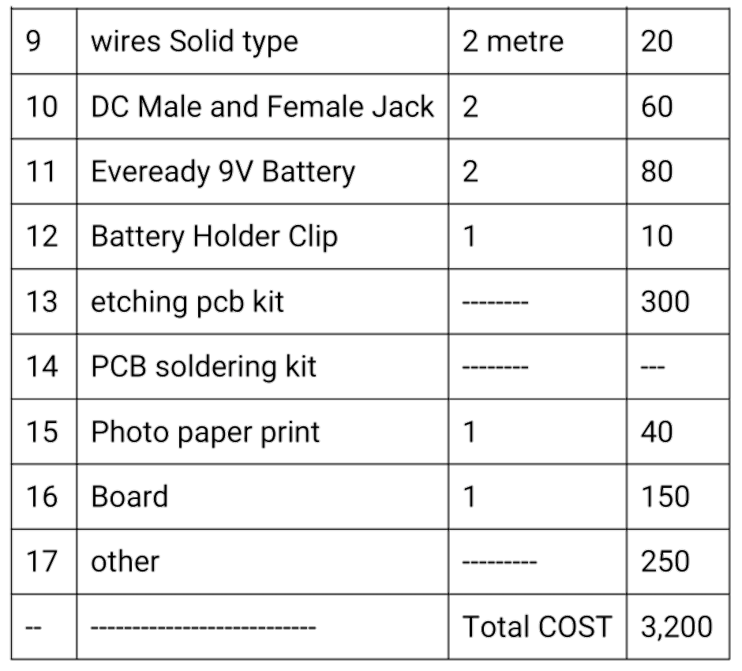

Slide 8

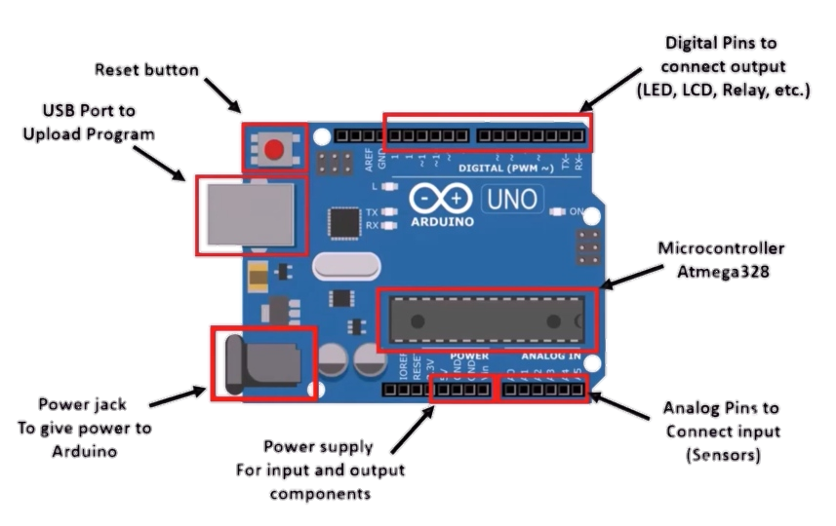
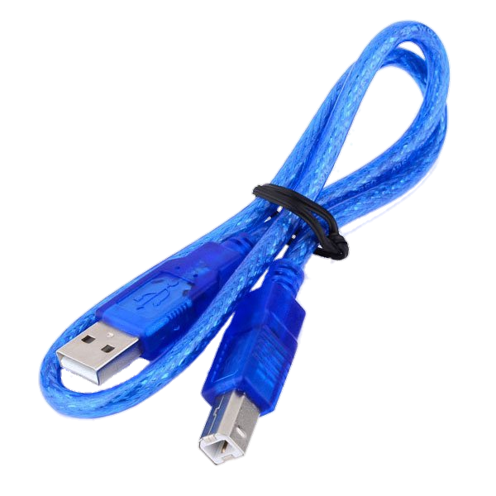
Arduino UNO Hardware:-
Arduino UNO cable type A/B

Slide 9
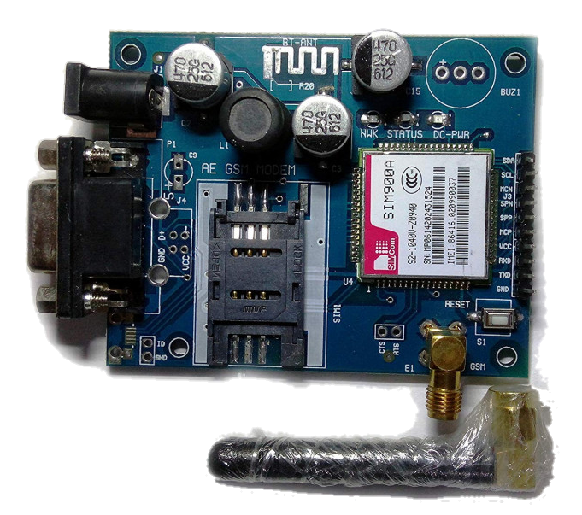
SIM 900A GSM Module:-

Slide 10
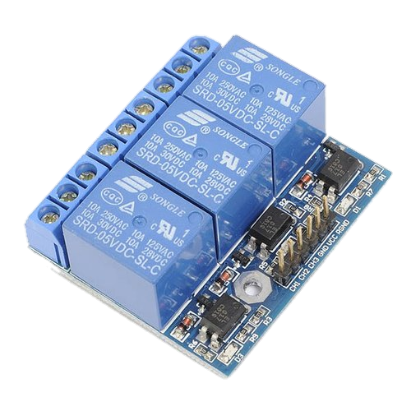
3 Channel Relay

Slide 11
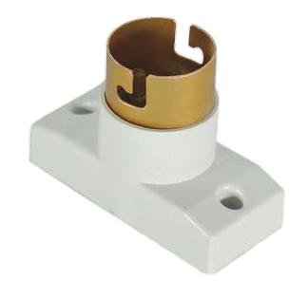
Bulb Holder:-

Slide 12
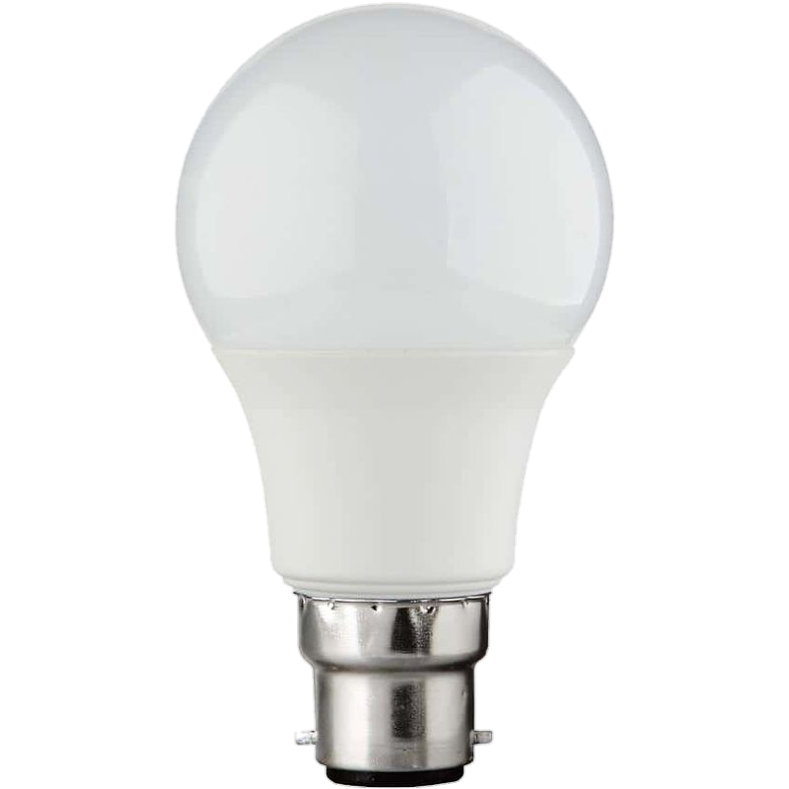
Bulb:-

Slide 13
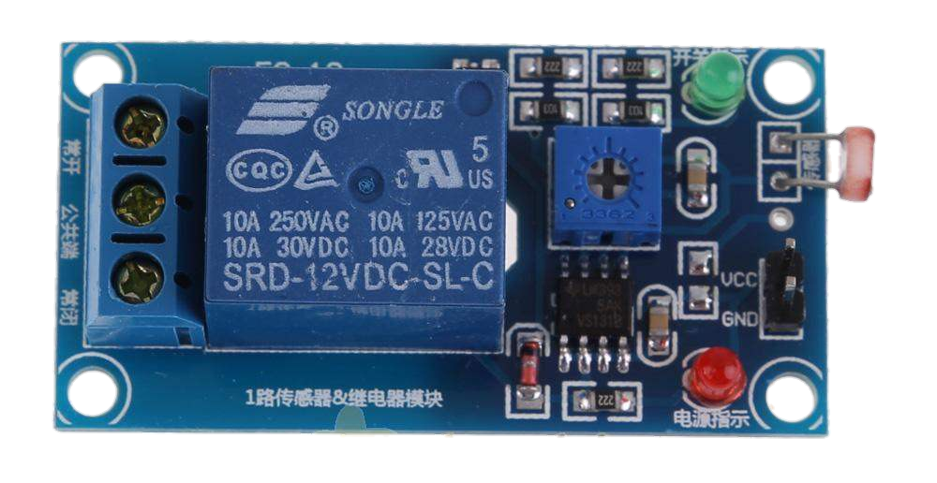
relay light detector sensor:-

Slide 14
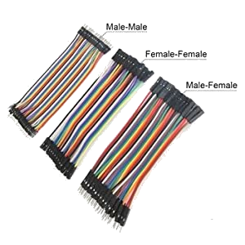
Jumper Wires Hardware:-

Slide 15
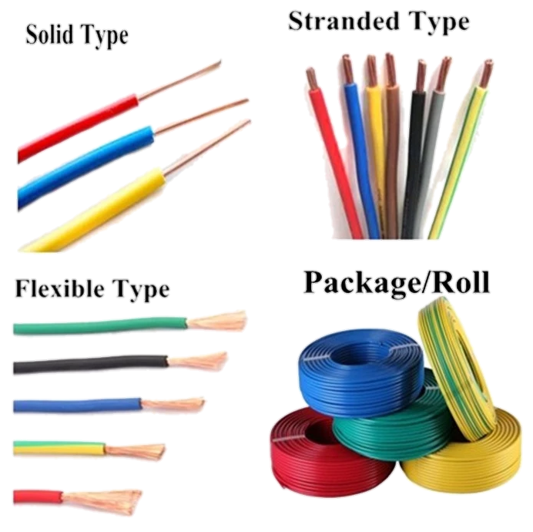
wires Solid type:-

Slide 16
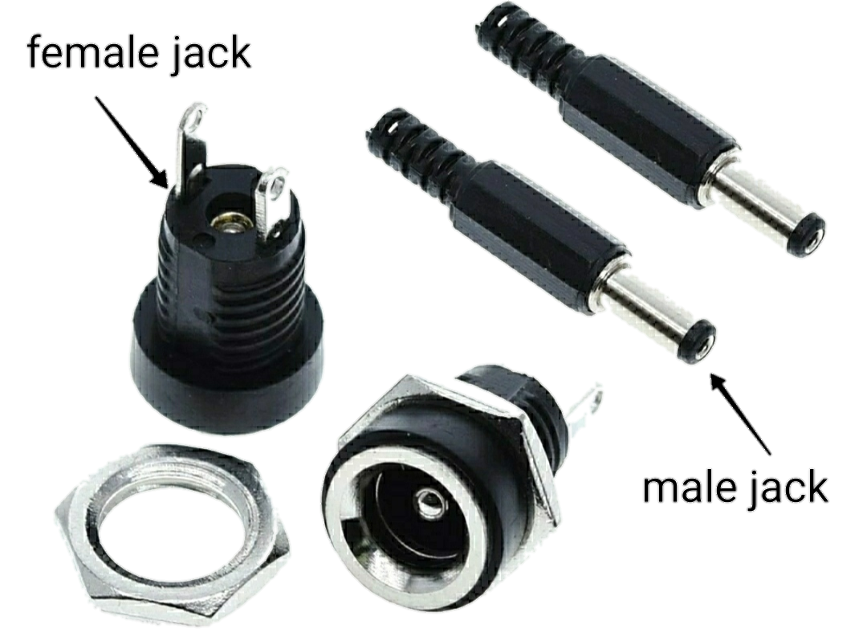
DC Male and Female Jack Combo:-

Slide 17
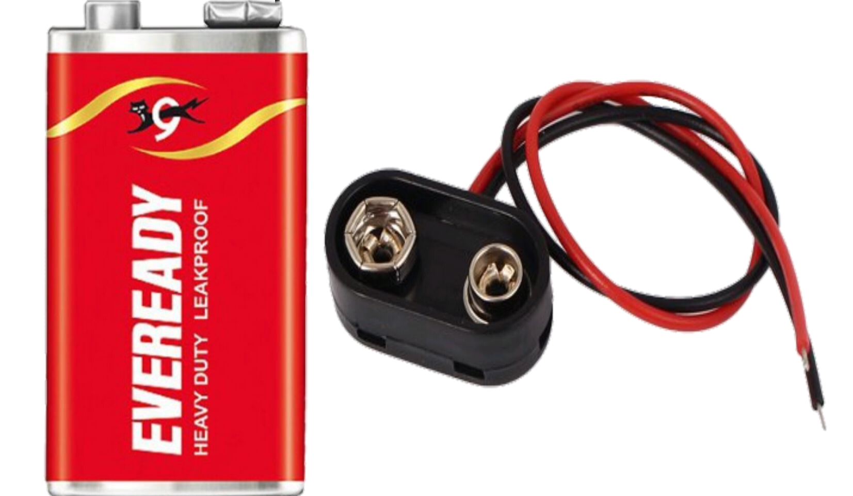
Eveready 9V Battery and Battery Holder Clip:-

Slide 18
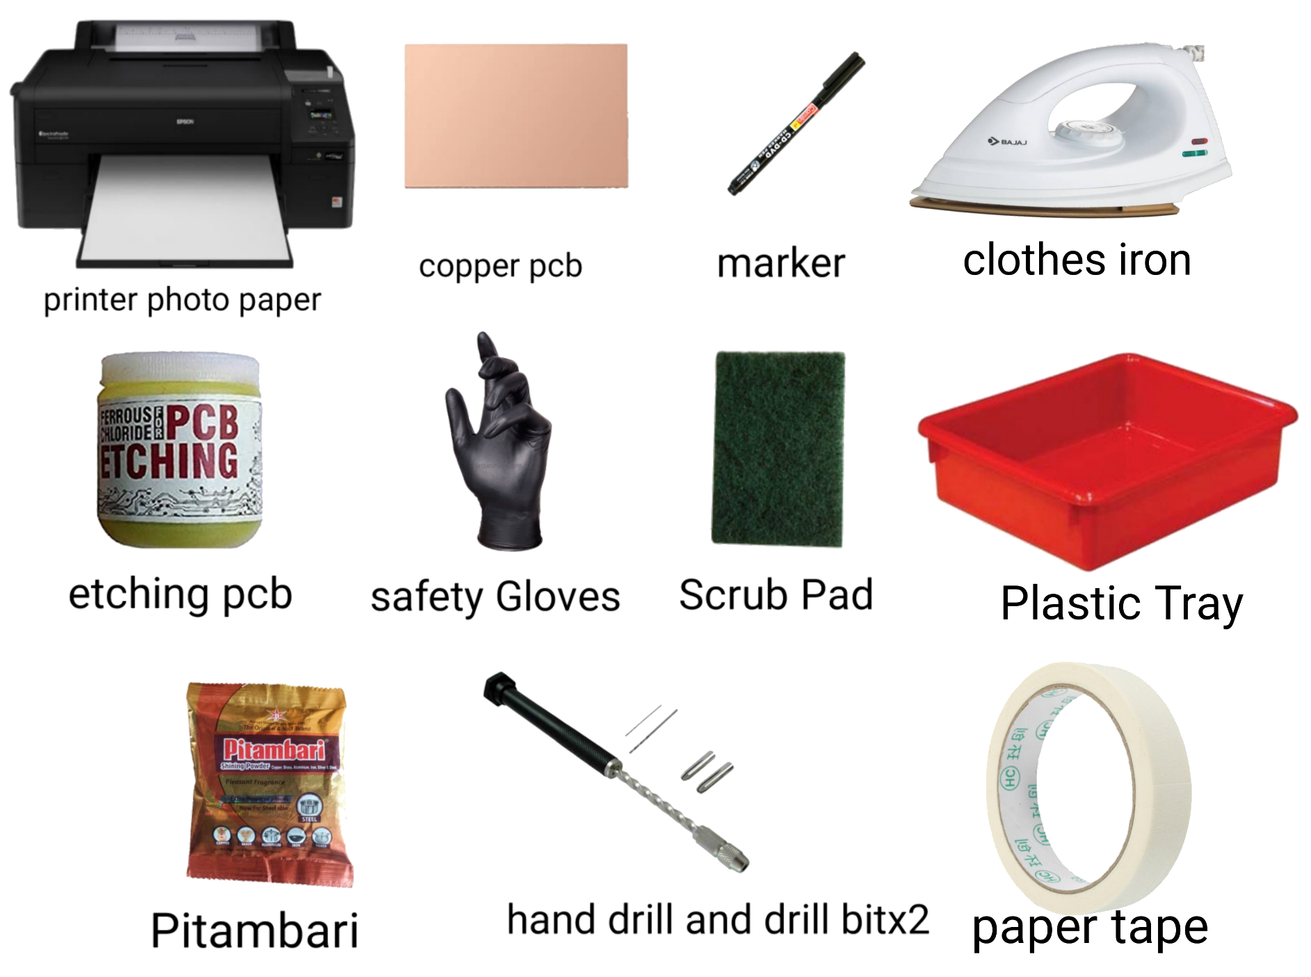
etching pcb kit:-

Slide 19
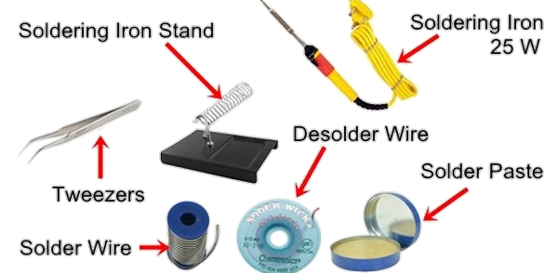
soldering iron kit:-

Slide 20
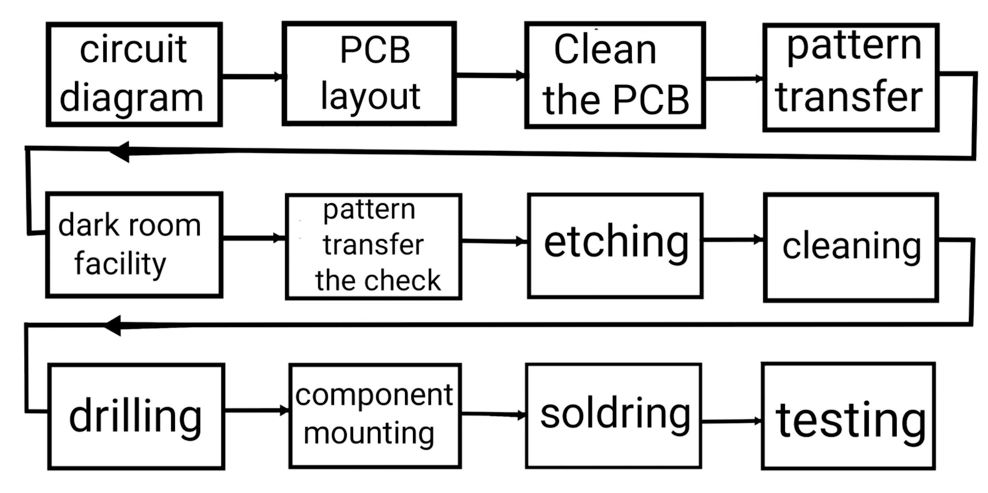
PCB manufacturing block diagram:-

Slide 21
STEP 1: circuit diagram Proteus is a simulation and design software tool developed by Labcenter Electronics for Electrical and Electronic circuit design. It is a software suite containing schematic, simulation as well as PCB designing. STEP 2: PCB layout First you need to design the PCB layout using a service like Eagle, Take the printout of PCB layout bottom view on Photo paper using LASER Printer. Note:- For printing, use LASER PRINTER or PHOT COPIER only because the ink used in them is plastic toner ink.

Slide 22
In other printer ink used is in liquid form which will not transfer to copper after heating Use Photo Paper OR Press & Peel magazine cover with gloss lamination. paper OR any STEP 3: Clean the PCB THE COPPER PLATE SO THERE IS A ROUGH SURFACE FOR THE DESIGN TO STICK TO WHEN TRANSFERED STEP 4: pattern transfer Place the print out sheet face down on copper Fix it using the paper tape . Turn on Electric Iron and set the maximum temperature available.

Slide 23
Give the maximum pressure and temperature up to 5 minute to the copper laminated sheet from photo paper side. After 5 minute keep this copper laminated sheet water for soaking. Wait for 1 minute or until paper softens Photo paper softens almost immediately, turning into a pulp that is easy to remove rubbing with your thumb. Keep rubbing until the paper gets dissolved (usually less than 1 minute). STEP 5: dark room facility

Slide 24
STEP 6: pattern transfer the check Check what has happened on the pattern transfer STEP 7: etching Using FeClz in a plastic tray, do the etching of PCB and remove the unwanted copper. Note: FeClz is an acid so while doing the etching keep your body and cloths away from the FeCl3. It is not too dangerous for body; you can wash your body by soap. But it is dangerous for cloths. Once you cloths are in contact with FeCla, your cloths are damaged.

Slide 25
STEP 8: cleaning After etching, the next procedure is to clean the PCB by removing the plastic toner. Using acetone remove the plastic toner. STEP 9: drilling Take the drill machine and drill bit. STEP 10: component mounting The two diagrams below show: 1. Track side of a PCB (normally the underneath side) and 2.The component side (normally the top side) of the same circuit. Take the 5v power supply PCB Mount the components as per the circuit diagram.

Slide 26
Note: Components are placed on the non-copper side, and then the PCB is turned over to solder the component leads to the copper tracks. Take precaution of terminals while mounting 16×2 LCD Display,Potentiometer 10K,Connecting Jumper Wires,Pulse Oximeter Sensor MAX30100 Module,DC Male and Female Jack,Eveready 9V Battery and Battery Holder Clip and IC. STEP 11: soldring Take the soldering gun. And prepare it for soldering. Place the soldering iron in its stand and plug in.

Slide 27
The iron will take a few minutes to reach its operating temperature of about 400°C. Wait a few minutes for the soldering iron to warm up. You can check if it is ready by trying to melt a little solder on the tip. Wipe the tip of the iron on the damp sponge. This will clean the tip. Melt a little solder on the tip of the iron. This is called 'tinning' and it will help the heat to flow from the iron's tip to the joint. It only needs to be done when you plug in the iron. Do the soldering. Check the soldering and if there is any dry soldering, do the corrective action using soldering After soldering cut the terminals by cutter.

Slide 28
Note: Don't cut the terminals before the soldering. Always cut the terminals after soldering. STEP 12: testing Is not soldering perfect? Check with multimeter.

Slide 29
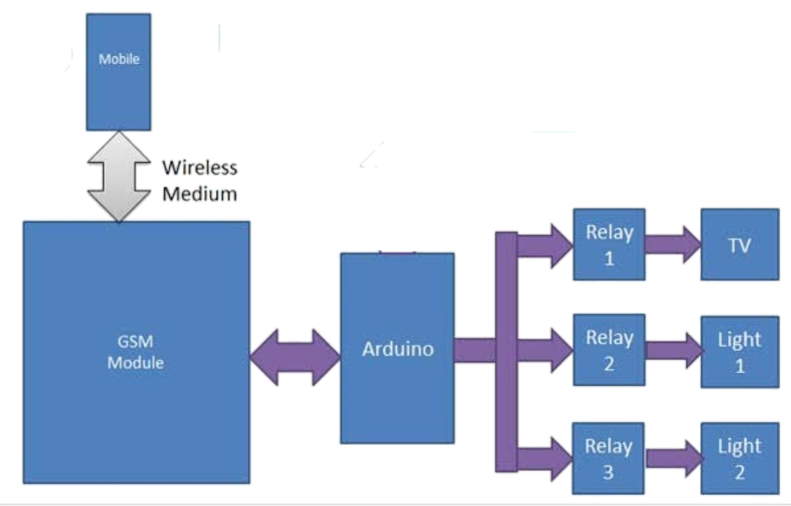
Block diagram:-

Slide 30
what is Block diagram ?
A block diagram is a diagram of a system in which the principal parts or functions are represented by blocks connected by lines that show the relationships of the blocks. They are heavily used in engineering in hardware design, electronic design, software design, and process flow diagrams.
The diagram above describes how the circuit diagram will be connected.

Slide 31
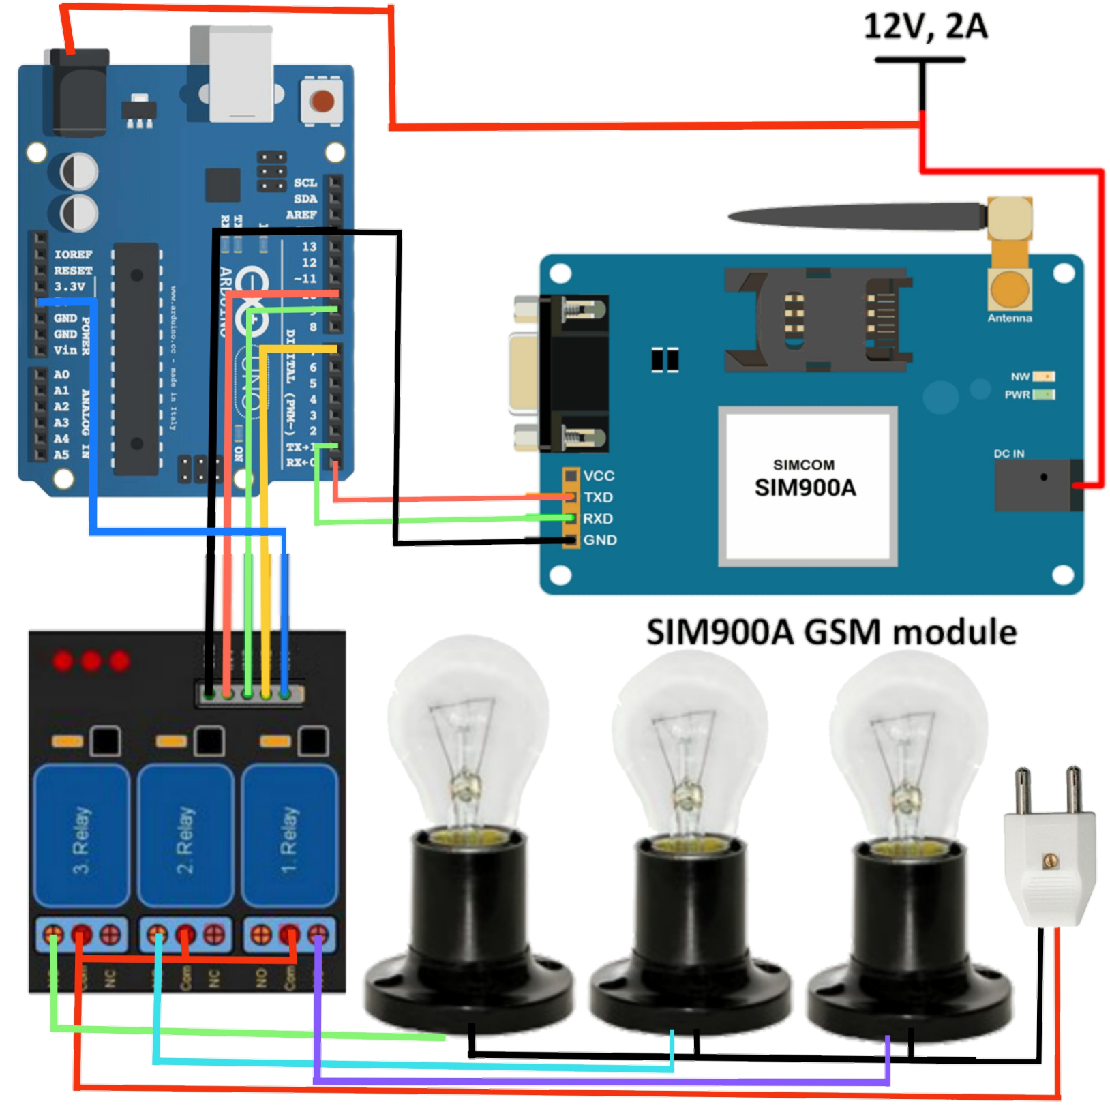
Arduino UNO diagram:-

Slide 32
The Arduino can be powered via VIN pin or USB or even using on-board DC jack, however the GSM modem should be powered only via on-board DC jack using a wall adapter. The whole circuit can also be powered from a 9V wall adapter rated at 1 amp as shown in the diagram.
The Tx of the Arduino should connect to Rx of the GSM module and Rx of the Arduino should connect to Tx of the GSM module and ground to ground connection between Arduino and GSM must be made.
There are 5 relays to control five different gadgets independently. The relay voltage can be 9 to 12V, if you are using 12V relays then you should supply 12V to the circuit and this is the maximum.
The 5 relays are where it takes 5V signal from Arduino and switches 9 to 12V rated relay ON and OFF.

Slide 33
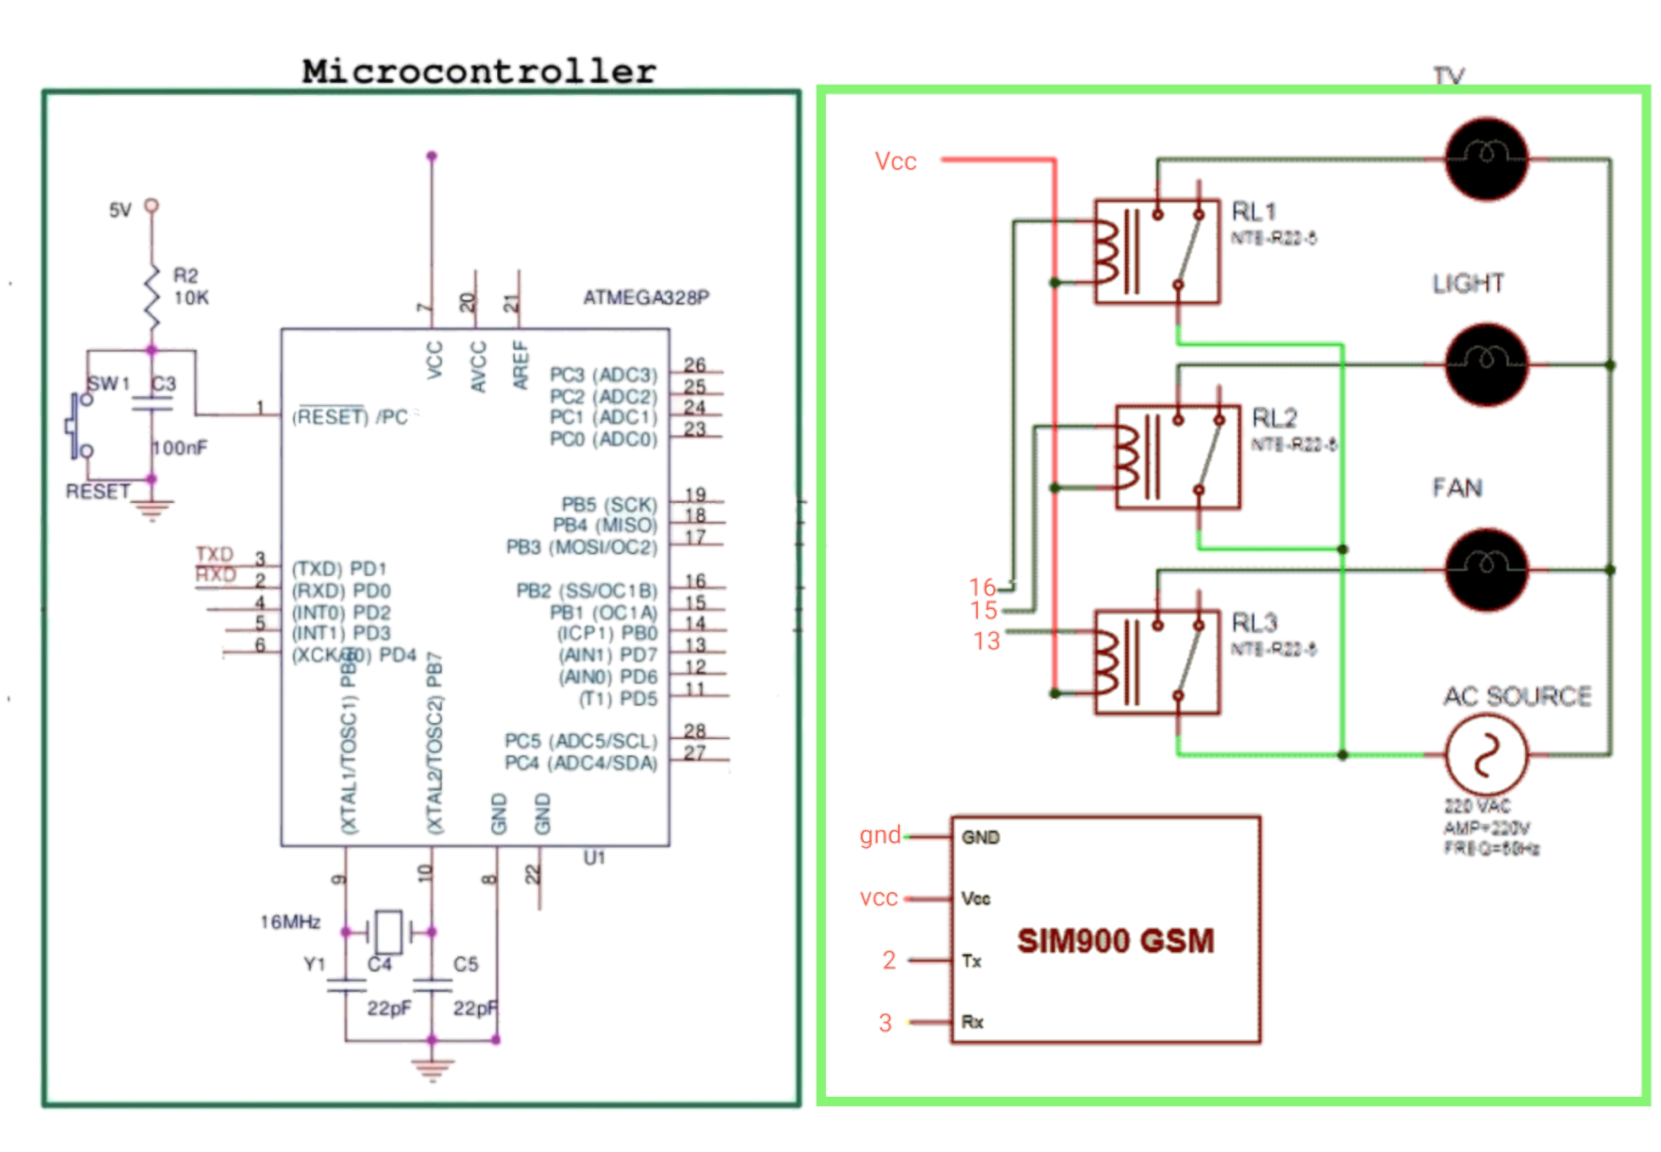
Microcontroller diagram:-

Slide 34
how is a Microcontroller diagram?
The diagram above describes how toinstall the Arduino ic and how the circuitdiagram will look like how the module,power supply and relay will be connected.

Slide 35
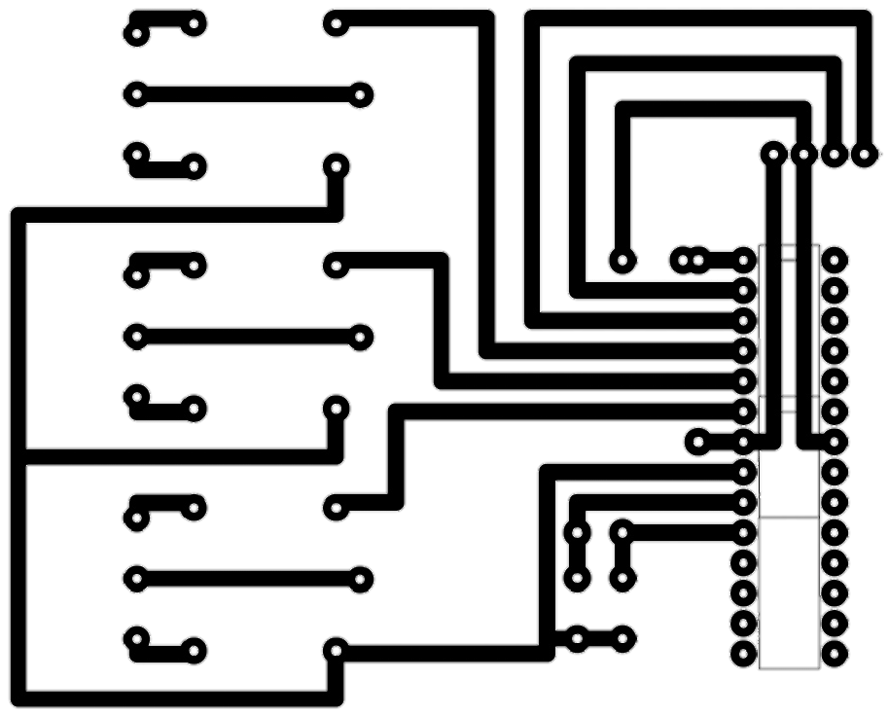
PCB diagram/layout :-

Slide 36
what is PCB diagram ?
Printed circuit board (PCB) design brings your electronic circuits to life in the physical form. Using layout software, the PCB design process combines component placement and routeing to define electrical connectivity on a manufactured circuit board.

Slide 37
Please click for full detail:- https://youtu.be/jXV1V33sT3U
Software Used:- Arduino ide program code language:- C++

Slide 38
Code:-
#define Fan 7
#define Light 9
#define TV 10
#define bulb 4
int temp=0,i=0;
int led=13;
char str[15];
void setup()
{
Serial.begin(9600);
pinMode(led, OUTPUT);
pinMode(Fan, OUTPUT);
pinMode(Light, OUTPUT);
pinMode(TV, OUTPUT);
pinMode(bulb, OUTPUT);
Serial.println("AT+CNMI=2,2,0,0,0");
delay(500);
Serial.println("AT+CMGF=1");
delay(1000);
}
void loop()
{
if(temp==1)
{

Slide 39
check();
temp=0;
i=0;
delay(1000);
}
}
void serialEvent()
{
while(Serial.available())
{
if(Serial.find("#A."))
{
digitalWrite(led, HIGH);
delay(1000);
digitalWrite(led, LOW);
while (Serial.available())
{
char inChar=Serial.read();
str[i++]=inChar;
if(inChar=='*')
{
temp=1;
return;
}
}
}

Slide 40
}
}
void check()
{
if(!(strncmp(str,"tv on",5)))
{
digitalWrite(TV, HIGH);
}
else if(!(strncmp(str,"tv off",6)))
{
digitalWrite(TV, LOW);
}
if(!(strncmp(str,"bulb on",7)))
{
digitalWrite(bulb, HIGH);
}
else if(!(strncmp(str,"bulb off",7)))
{
digitalWrite(bulb, LOW);
}
else if(!(strncmp(str,"fan on",6)))
{
digitalWrite(Fan, HIGH);
}
else if(!(strncmp(str,"fan off",7)))
{

Slide 41
digitalWrite(Fan, LOW);
}
else if(!(strncmp(str,"light on",8)))
{
digitalWrite(Light, HIGH);
}
else if(!(strncmp(str,"light off",9)))
{
digitalWrite(Light, LOW);
}
else if(!(strncmp(str,"all on",6)))
{
digitalWrite(Light, HIGH);
digitalWrite(Fan, HIGH);
digitalWrite(TV, HIGH);
digitalWrite(bulb, HIGH);
}
else if(!(strncmp(str,"all off",7)))
{
digitalWrite(Light, LOW);
digitalWrite(Fan, LOW);
digitalWrite(TV, LOW);
digitalWrite(bulb, LOW);
}
}

Slide 42
ADVANTAGES:-
Devices can be controlled from long distances.
Economical design
Can be easily implemented in homes
Can be used by everyone with just the knowledge of text SMS
Format of the SMS is simple to understand and write

Slide 43
DISADVANTAGES:-
The system is network dependent. Hence, network congestion can reduce the reliability of the system.
If user make any mistake while typing the message format, the message will not be acknowledged by Arduino hence the system will not work.

Slide 44
FUTURE SCOPES:-
The project "GSM BASED HOME CONTROL" is intended to automate the certain functions of home appliances. Smart home technologies have been around for about 30 years, mostly relying on some proprietary technologies and applications. With the recent expansion of communication networks, smart home applications can be further enhanced with new dimension of capabilities that were not available before. In particular, wireless access technologies will soon enable exotic and economically feasible applications. The device is much helpful in controlling home. It reduces the wastage of valuable time and our daily life become easier and flexible.

Slide 45
CONCLUSIONS:-
The main purpose of the project is to provide a smart and efficient way to control our home appliances with the help of modern communication technology. With the combination of Arduino and GSM this project is not only a modern approach to next generation home but also a very friendly and easy to use system. This project will give our daily life a new dimension at the same time it will help us to save energy.

